Slide 3
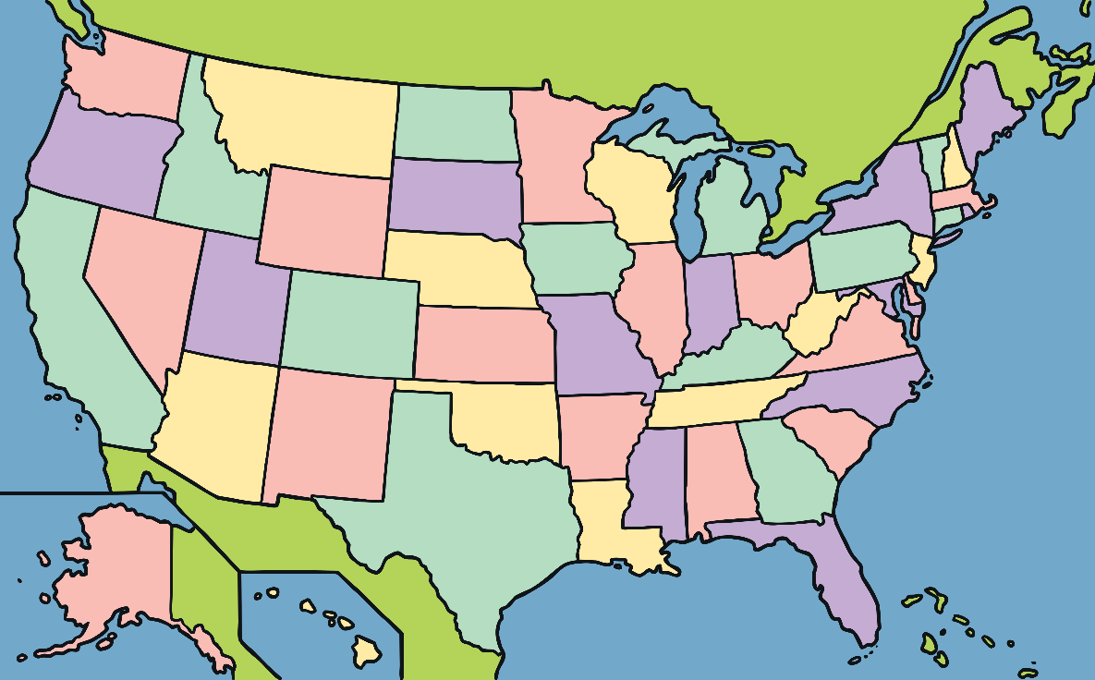
What Is Earth Day?
The first Earth Day was held in 1970 in America.
Earth Day was started to encourage people around the world to think and learn about what we can do to look after our planet.

Slide 4
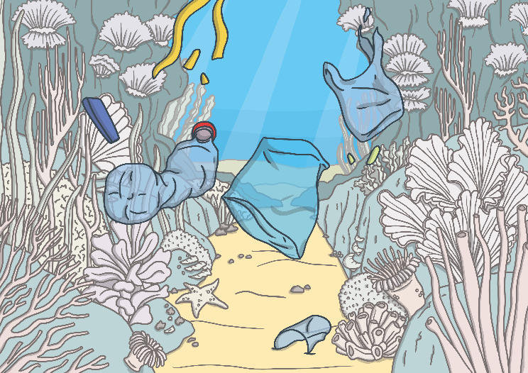
When Is Earth Day?
Earth Day is held on the 22nd of April every year.
April
The theme for Earth Day in 2024 is ‘Planet vs Plastics’.

Slide 5
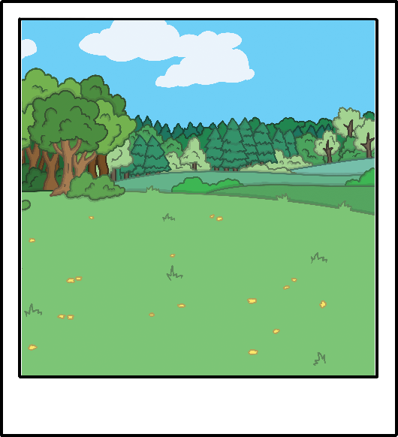
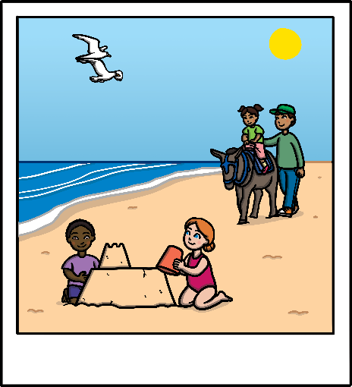
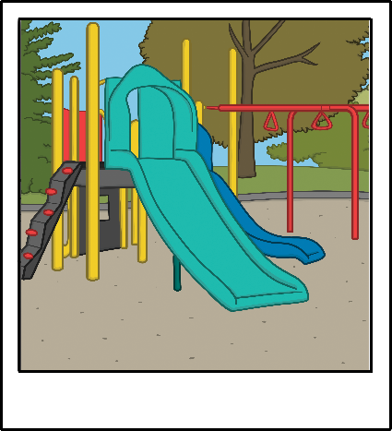
Planet Earth
Our planet is amazing and beautiful.
Think about your favourite outside place.
What do you like about this place? What makes it special?
Is it the countryside?
Is it the seaside?
Is it the park?

Slide 6
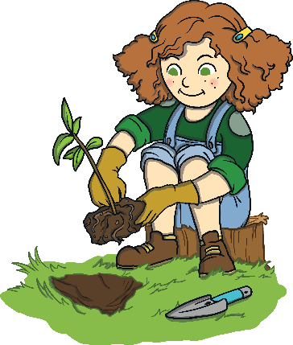
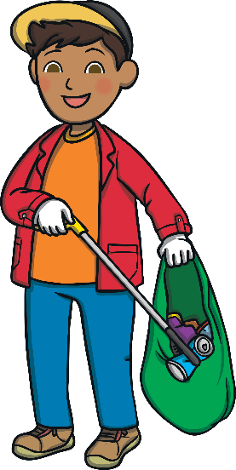
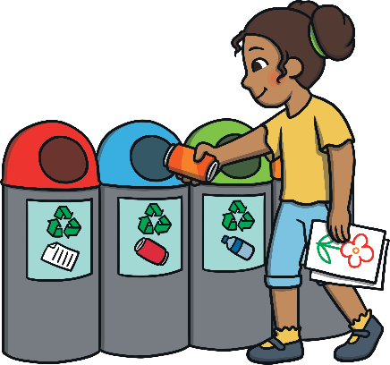
Looking After Our Planet
Earth Day helps us learn about ways to look after our planet.
We can do these things all year round, not just on Earth Day.
Have you done any of these things?
Click on each picture to find out more!
planting trees and flowers
picking up litter
recycling

Slide 7
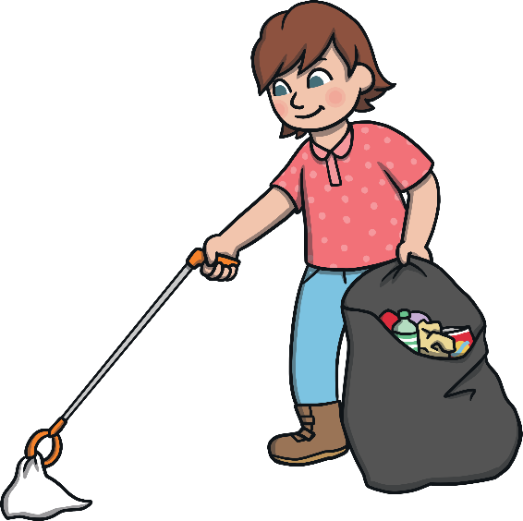
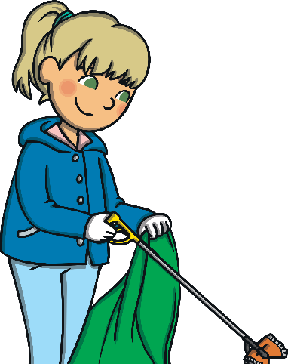
Picking Up Litter
Picking up litter helps to protect the environment.
It is important to pick up litter so that it does not harm plants and animals and does not get washed or blown into rivers and seas.
You could ask a grown-up to help you with a litter-picking activity. Make sure you wear gloves and that you wash your hands after picking up any litter.

Slide 8
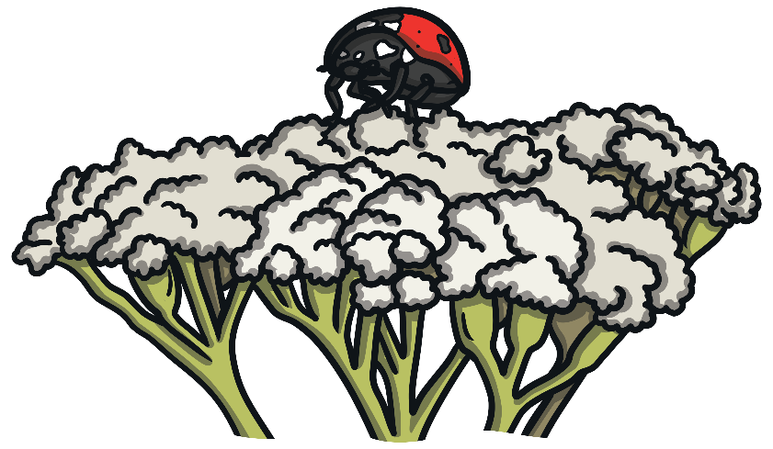
Planting Trees and Flowers
Trees, plants and flowers provide food and homes for animals. They also help to create clean air for us to breathe.
You could ask a grown-up to help you plant some trees or flowers.
You might see some wildlife, such as minibeasts, around the trees and flowers you plant.

Slide 9
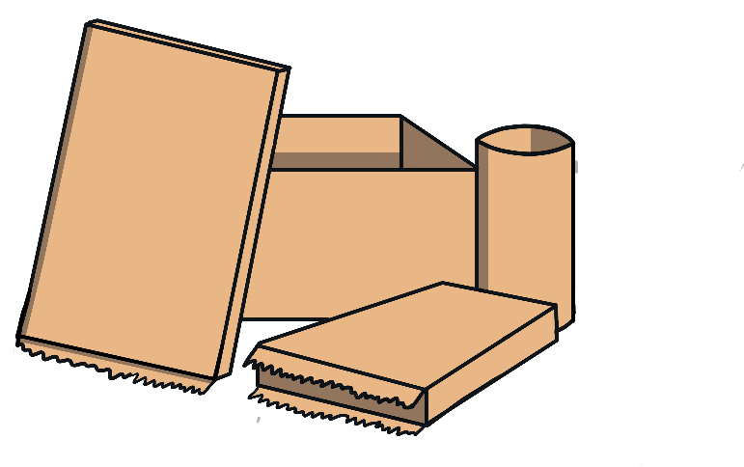
Recycling
Some materials can be recycled. This means that once we’re finished with them, they can be turned into new things for us to use.
Plastic, paper and glass are some materials that can be recycled.
You could help by sorting items to be recycled. Do you have a recycling bin at home?
Some items can also be reused before they are recycled. You could use an empty yoghurt pot to wash paintbrushes or as a plant pot.

Slide 10
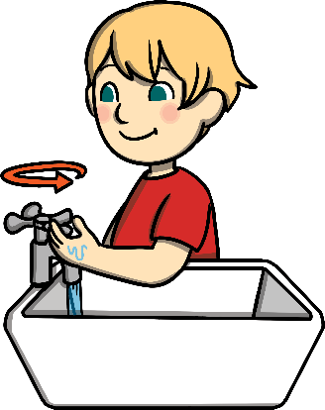
Looking After Our Planet
Can you help the grown-ups at school and at home to do these things?
This year, Earth Day hopes to tackle plastic waste for a greener future.
How do you think these activities help to look after our planet?
Click on a picture below to find out more!
turn off lights
use eco-friendly products and less plastic
use less water

Slide 11
Turn Off Lights
Switching off lights when they are not needed helps to save energy.
When you leave a room, remind a grown-up to switch off the light.
Other things can also be switched off when they are not being used to help us save energy, such as TVs and computers.
Click here to switch off the lights!

Slide 12
Turn Off Lights
Switching off lights when they are not needed helps to save energy.
When you leave a room, remind a grown-up to switch off the light.
Other things can also be switched off when they are not being used to help us save energy, such as TVs and computers.
Great job!

Slide 13
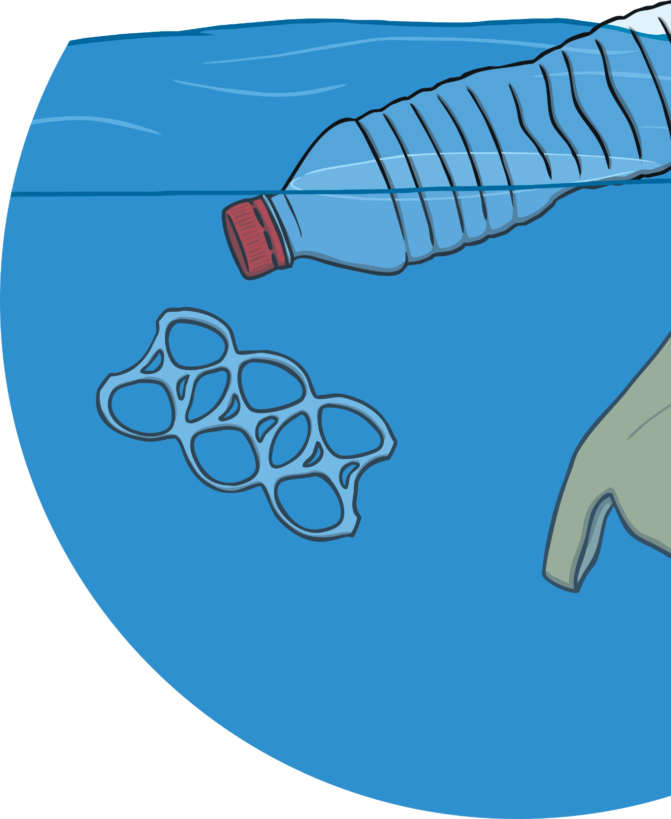
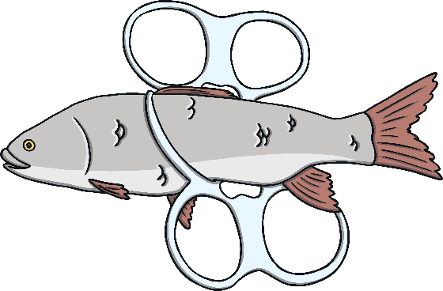
Eco-Friendly Products
Lots of things we use are often made of plastic.
Plastic can be harmful to the environment. It takes a long time to break down and can harm plants and animals.
Instead, you can try to use eco-friendly products that are made from other materials, such as fabric or paper.
For example, instead of plastic carrier bags, you could use a fabric bag when you go to the shops.

Slide 14
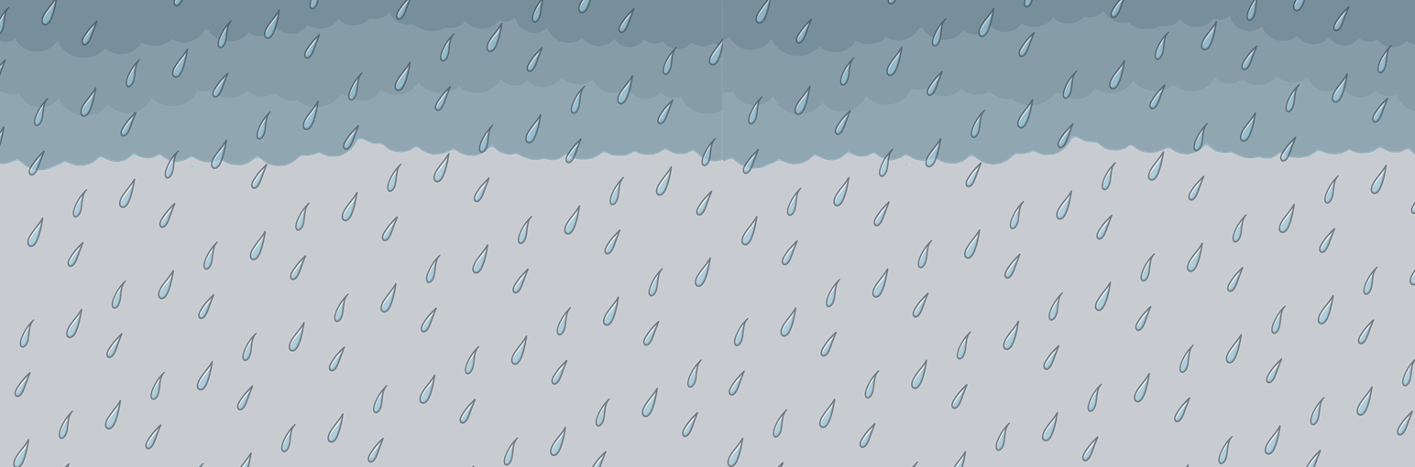
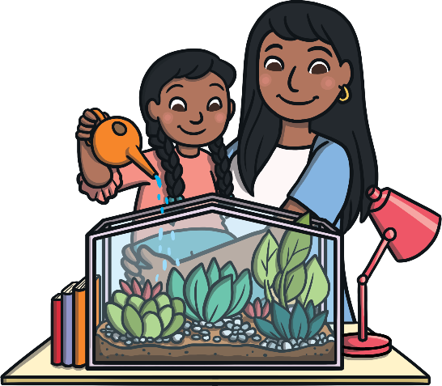
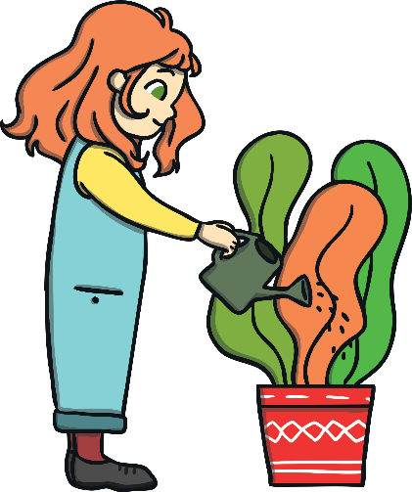
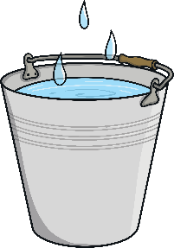
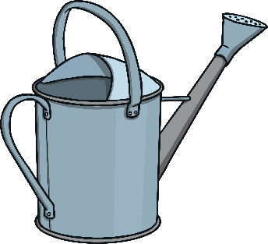
Use Less Water
We can help to save water in many ways, such as turning taps off after washing our hands or when we are brushing our teeth.
Outside, rainwater can be collected in large buckets or containers. This water can be used to water plants and wash cars or windows.

Slide 15
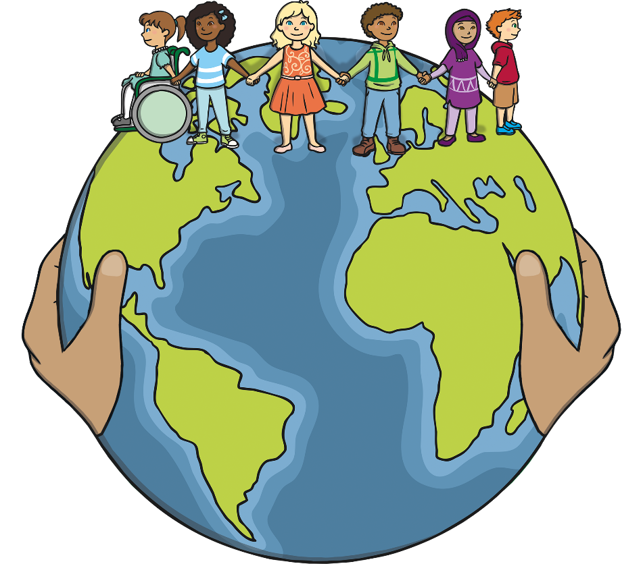
What Did You Learn?
What did you learn about Earth Day?
April
Tell a friend about something you are going to do to help look after our planet!

